Slide 1


Decoding
Popularity
Team 2A
Abhinav Samavedula, Chun Hui Tsai, Hilary Nguyen, Lalitha Bhupalam, Ruicheng Li
Notes:
Hello we are Team 2A. Today we’re here to talk about our project Decoding Youtube Popularity.

Slide 2

Agenda
Introduction
Data Description
Text Analysis
Inspiration
Data Cleaning
Findings
Questions for Exploration
Data Visualization
Conclusions
Data Source
Classification
Notes:
Introduction
Inspiration
Questions for exploration
Data source
Data description
Data cleaning
Data visualization
NLP
Classification of trending and non trending data
Findings
Conclusion

Slide 3

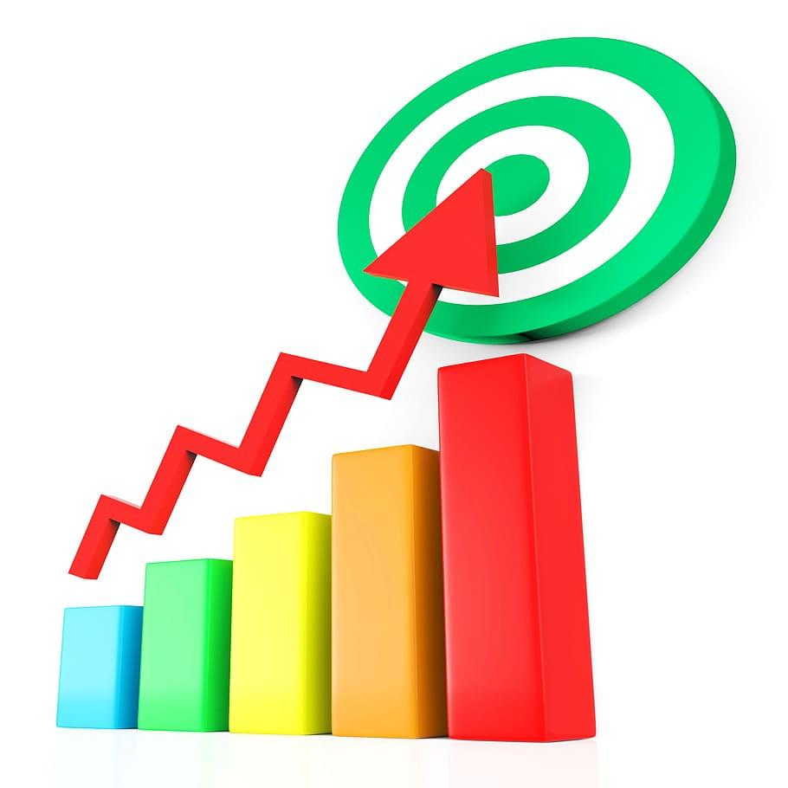
Introduction
With over 2.51 billion monthly users in 2023, the platform stands at the forefront as a principal platform for video sharing and content creation.
Notes:
As I’m sure everyone knows, Youtube has become part of our daily life. From learning how to do organic chemistry, to travel vlogs to music videos, youtube has it all. It has become a platform that connects people. Therefore, it is no wonder that Youtube is the top video sharing and content creation platform with over 2.51 billion monthly users. Since it has so many users, it can be a little difficult to achieve popularity on youtube. Hence we decided to analyze trending and non trending videos from youtube.

Slide 4
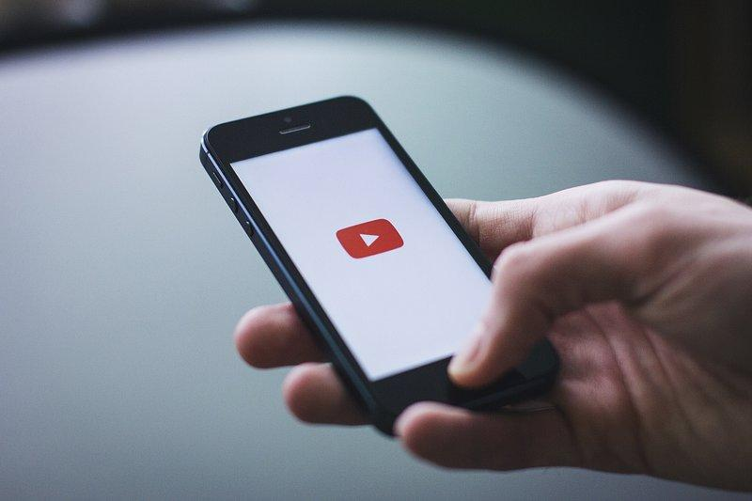
Inspiration
8 to 12 year olds want to be “Youtubers” (Connections Academy)
Case Study: By Medium 2020 “Data-Driven Tips to Make a Video Go Viral on YouTube”
Notes:
The inspirations for our topic:
According to an article by Connections Academy in 2022, when children between the ages of 8 and 12 are asked what they want to be when they grow up, many are saying “Youtuber” more now than ever. This leads to question…
So, how does one go viral to make a living off of Youtube? A case study from 2020 called “Data-Driven Tips to Make a Video Go Viral on YouTube” studied data in the US market and which channels are the most popular. This inspired us to study up-to-date Youtube data of our own to answer some questions for exploration.
https://medium.com/swlh/data-driven-tips-to-make-avideo-go-viral-on-youtube-e7117f51fc2f
https://www.connectionsacademy.com/support/resources/article/career-goals-among-children/

Slide 5
Questions for Exploration
What category do the trending videos on YouTube platform usually belong to?
What’s the best time in a day or week to upload videos?
1
3
2
What is the relationship between different metrics in a video, like views, likes, and comment counts?
4
Are there any key words or phrases that are common among popular videos?
Overall: What factors influence the popularity of a YouTube video?
Notes:
These were are 4 main questions throughout this project, all of them stemming from our main objective of analyzing which factors influence the popularity of a video on Youtube.

Slide 6

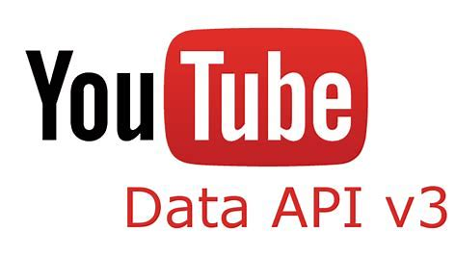
Data Source
Source 1: Kaggle Data set that is updated everyday which uses Youtube Data API v3 for getting trending videos by region
From 2020-2023
Notes:
For the Data source, we have obtained the trending data from Kaggle Dataset which is updated everyday. It uses Youtube Data API version 3 to collect data by using the chart parameter set to most popular. This collects all the data of trending videos for each region on that day. The dataset we found has daily data from 2020-2023 present day.

Slide 7
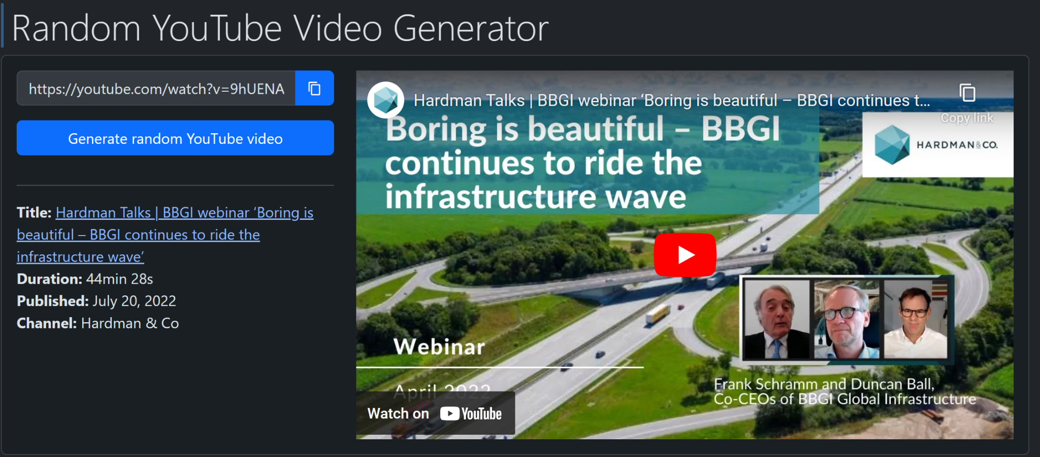

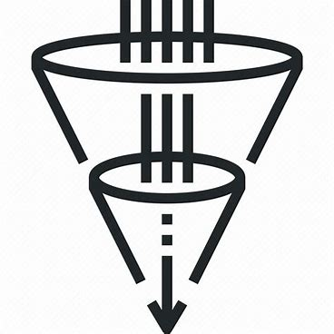

Data Source
Source 2: Web crawling devpicker.com’s random youtube video generator for non trending videos
+
= videoID
2020-2023
Notes:
For the non -trending data, we did not have a particular dataset. So we decided to web crawl a website called DevPicker.com. This website has a feature that generates random videos.
Since this feature picks very unseen videos that most people haven’t come across, we thought it would represent the non-trending data well. So we replicated the Http requests of this website to get the random video Ids and then used Youtube Data API to get the rest of the details about the video. Finally we checked if the video was published in the years 2020 - 2023 to ensure that the non-trending data matches the timeframe of publish as the data from the kaggle dataset.
Once we had both trending and non-trending data we combined them into a single dataframe adding a label field that captures whether the video is trending or non-trending . Then we shuffled the order of the rows to create our final dataframe.

Slide 8
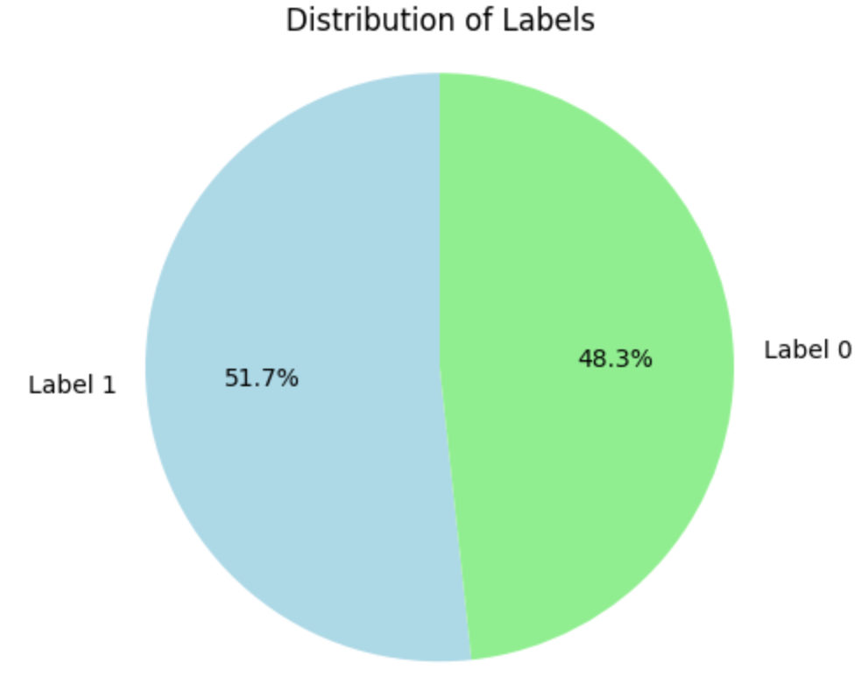
Data Description
16 columns x 3865 rows
video_id
channel_id
channel_title
category_id
trending_date
publishedAt
tags
view_count
likes
dislikes
comment_count
thumbnail_link
comments_disabled
ratings_disabled
description
label (trending:1 /non-trending:0)
Notes:
Coming to the data descriptions we have 3865 rows and 16 columns. Each row contains all the details of a video such as video and channel ids, titles, descriptions, engagement statistics etc. Also our class distribution is almost equal to 50 percent of each class.

Slide 9
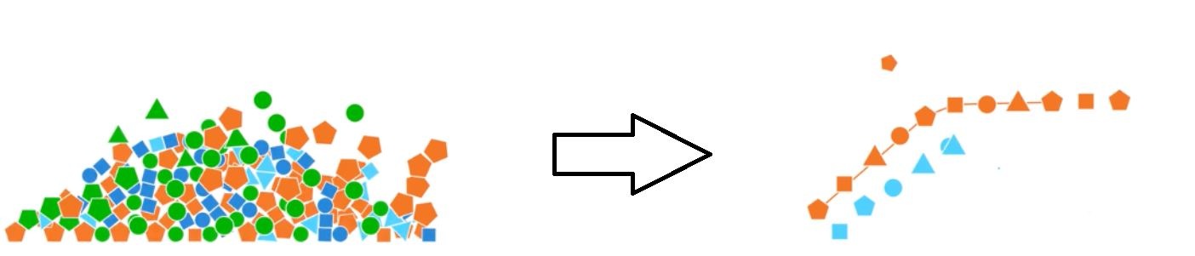
Data Cleaning
01 | Removing duplicates
02 | Removing unnecessary columns- video_id,channel_id,thumbnaillink etc
03 | Cleaning Tags which contain | as a separator
04 | Changing publishedAt and trending date to all be in the same format
05 | Converting category_id to actual category names
Notes:
Removing duplicates because web crawling the random youtube generator too many times means that we get some duplicates
Removing channel id, thumbnail link and 'video_id','channelId','thumbnail_link','comments_disabled','ratings_disabled'
Cleaning tags to remove the vertical bar - |
Making all the dates: published date and trending date be in the same format y m d
Converting category id to actual category names

Slide 10
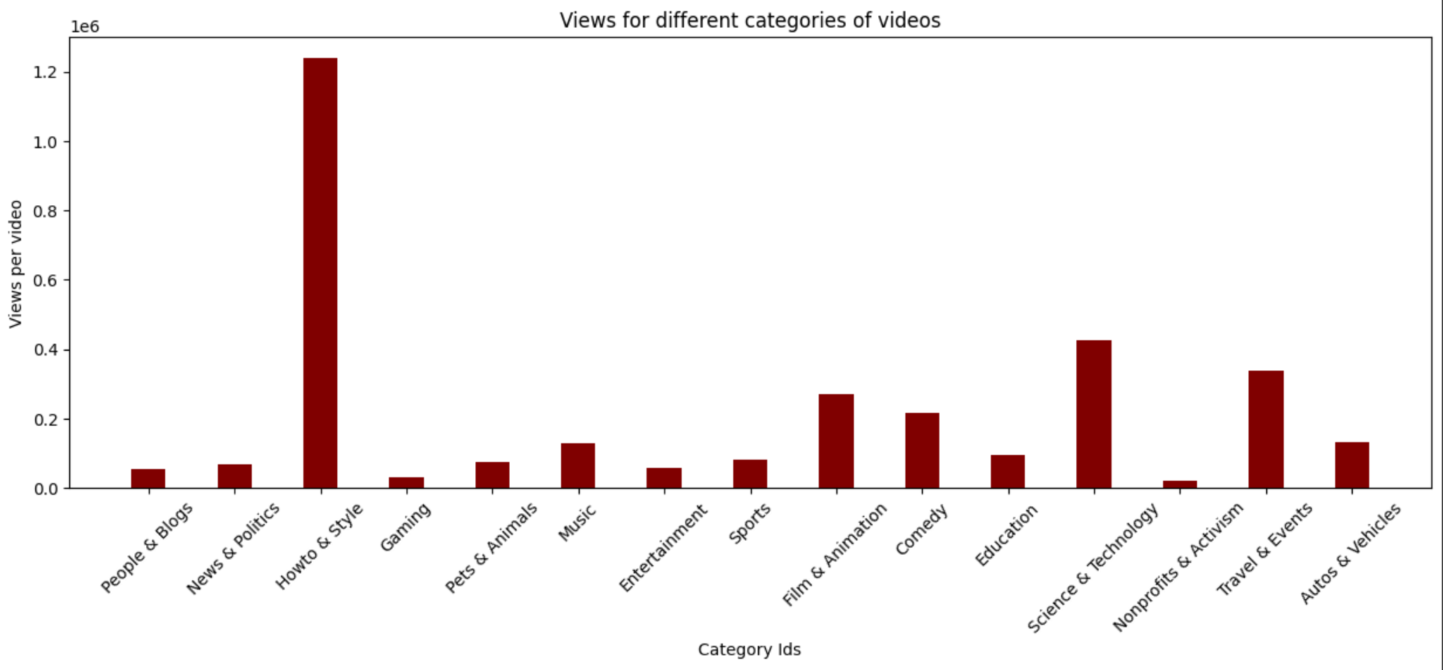
Data Visualization - Views per Category
Notes:
First we wanted to look at how different categories vary in views, likes, dislikes, comment counts. Since the number of videos in each category will vary we used the views per video ratio instead to perform this comparison. As we can see highest views are in ….. Highest likes in ….. Highest dislikes in …. Highest comments in ……….. Category.

Slide 11
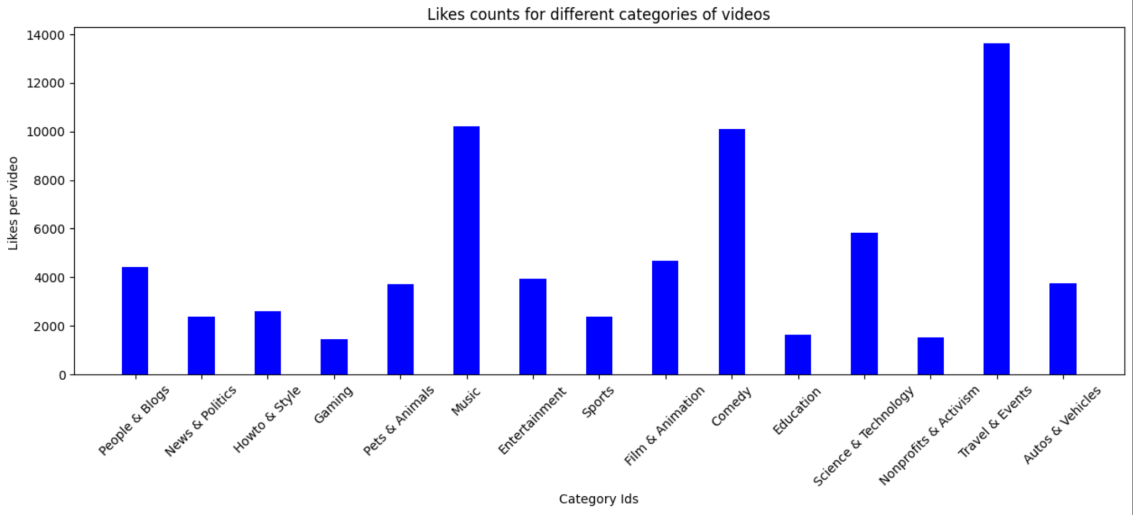
Data Visualization - Likes per Category
Notes:
First we wanted to look at how different categories vary in views, likes, dislikes, comment counts. Since the number of videos in each category will vary we used the views per video ratio instead to perform this comparison. As we can see highest views are in ….. Highest likes in ….. Highest dislikes in …. Highest comments in ……….. Category.

Slide 12
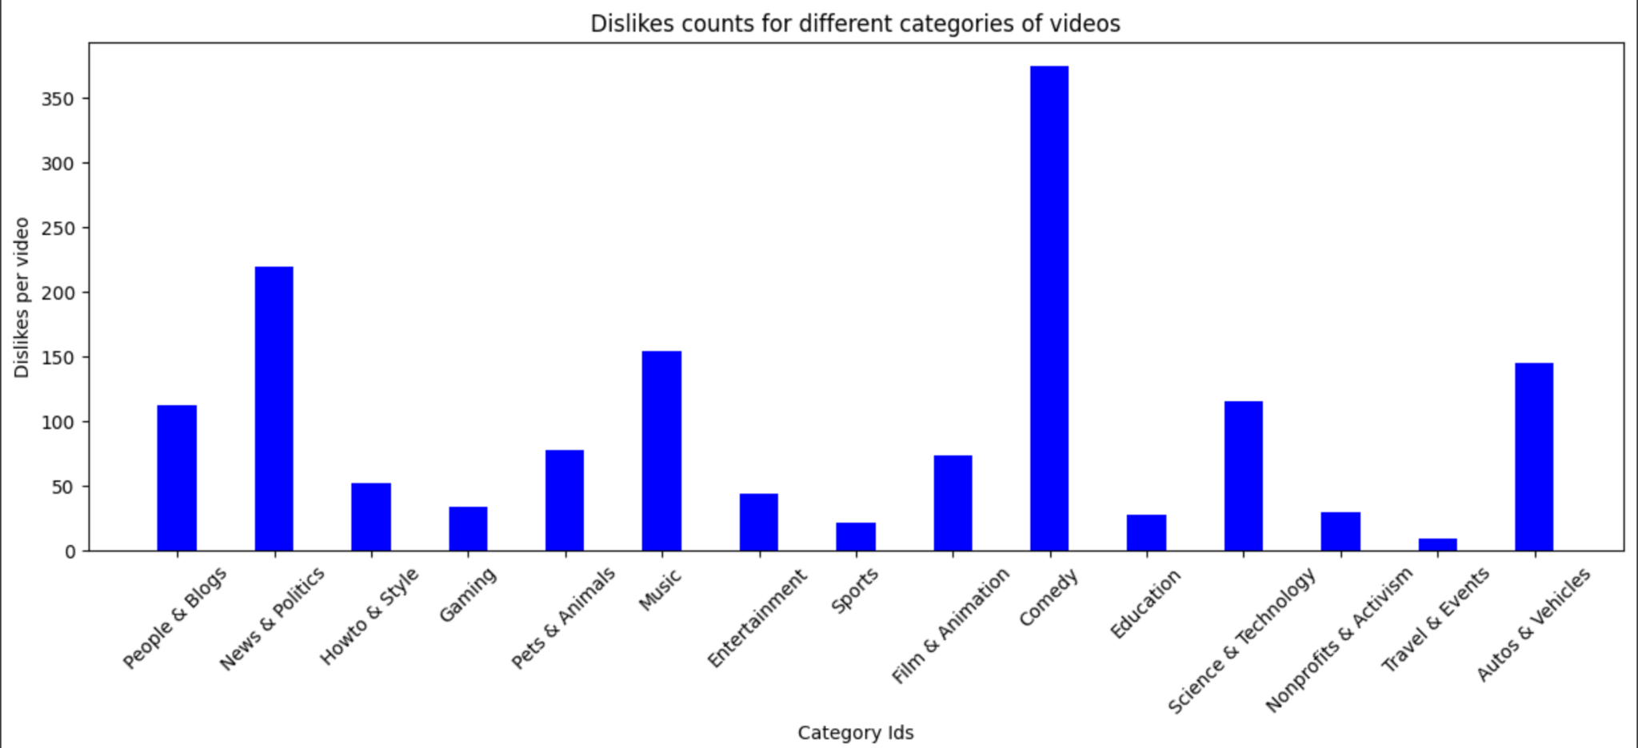
Data Visualization- Dislikes per Category
Notes:
First we wanted to look at how different categories vary in views, likes, dislikes, comment counts. Since the number of videos in each category will vary we used the views per video ratio instead to perform this comparison. As we can see highest views are in ….. Highest likes in ….. Highest dislikes in …. Highest comments in ……….. Category.

Slide 13
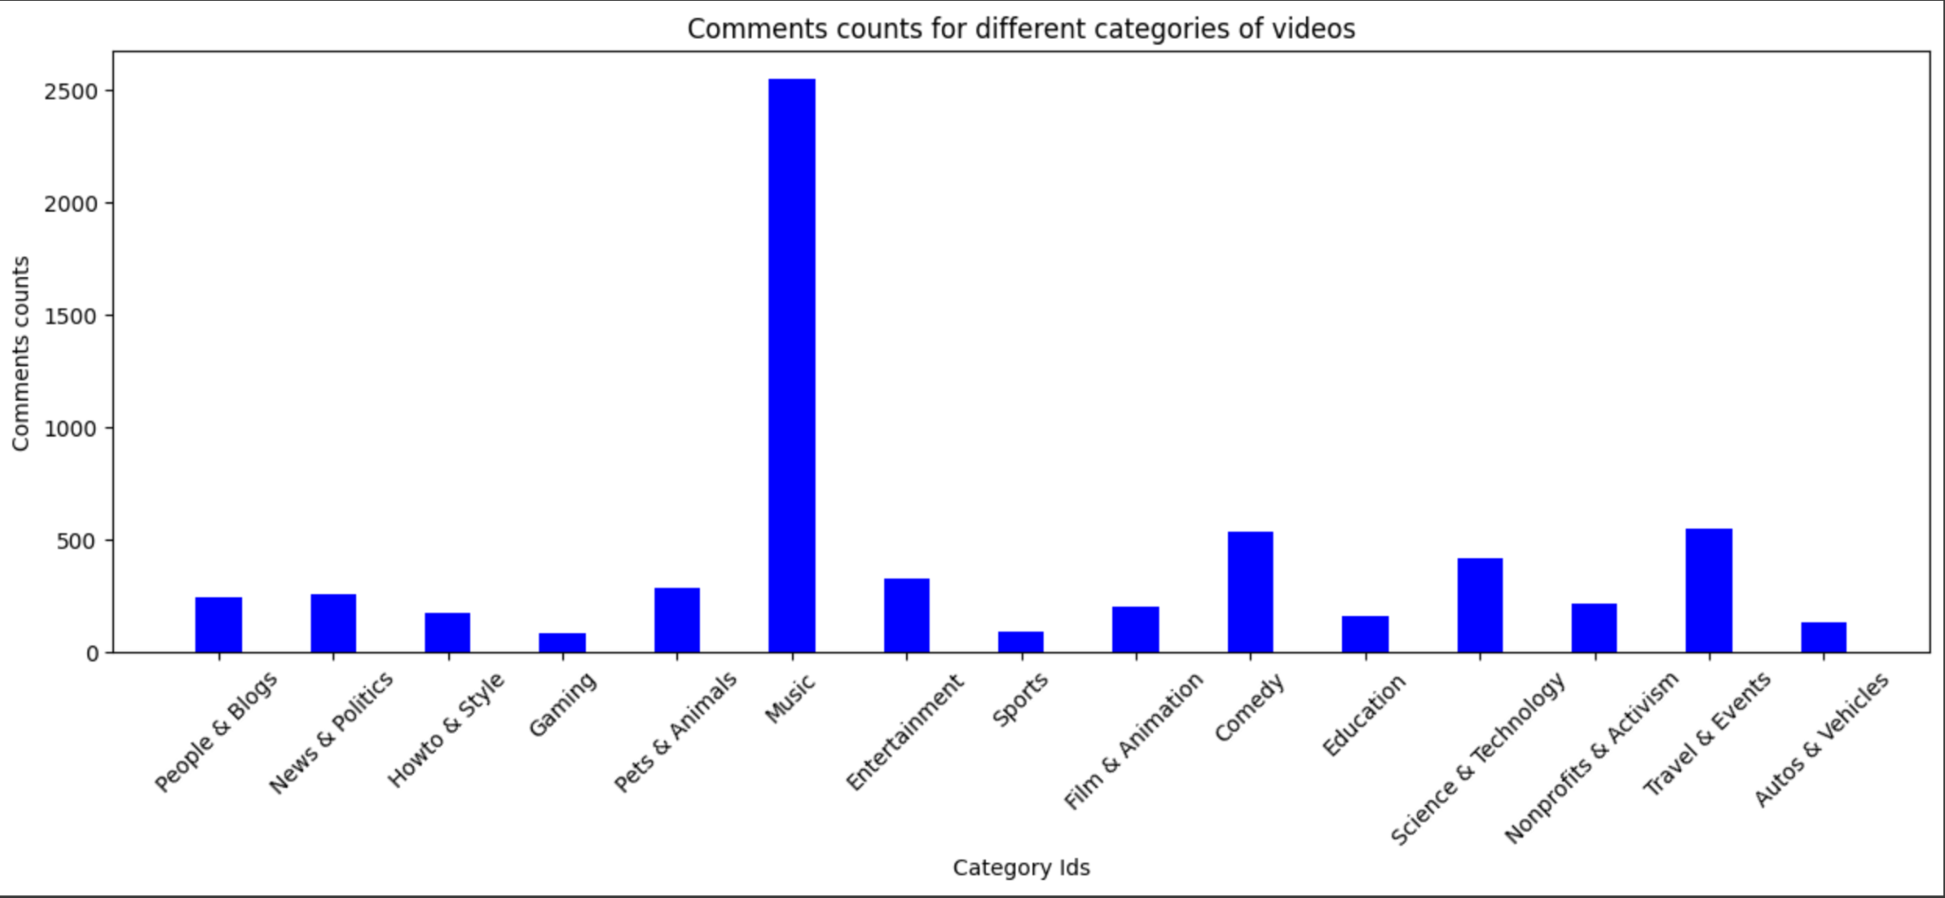
Data Visualization - Comments per Category
Notes:
First we wanted to look at how different categories vary in views, likes, dislikes, comment counts. Since the number of videos in each category will vary we used the views per video ratio instead to perform this comparison. As we can see highest views are in ….. Highest likes in ….. Highest dislikes in …. Highest comments in ……….. Category.

Slide 14
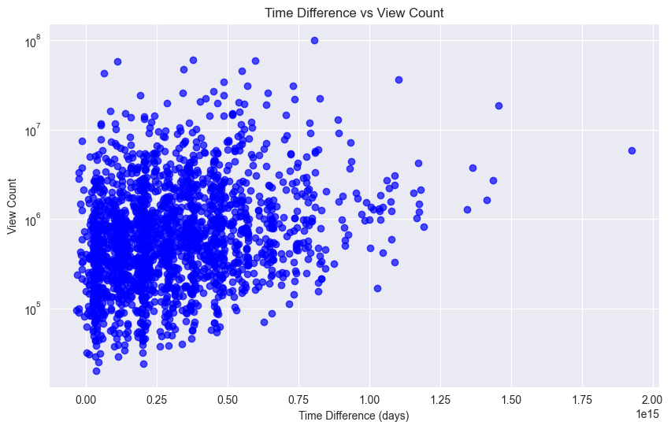
Data Visualization - Days
Notes:
Then we wanted to look at the gap between published date and trending date. We looked at only trending data for this analysis. We found that almost all trending videos were trending within 2 days of being published. And all of them within a month. So we observed that older videos have no chance of going trending after a month.

Slide 15
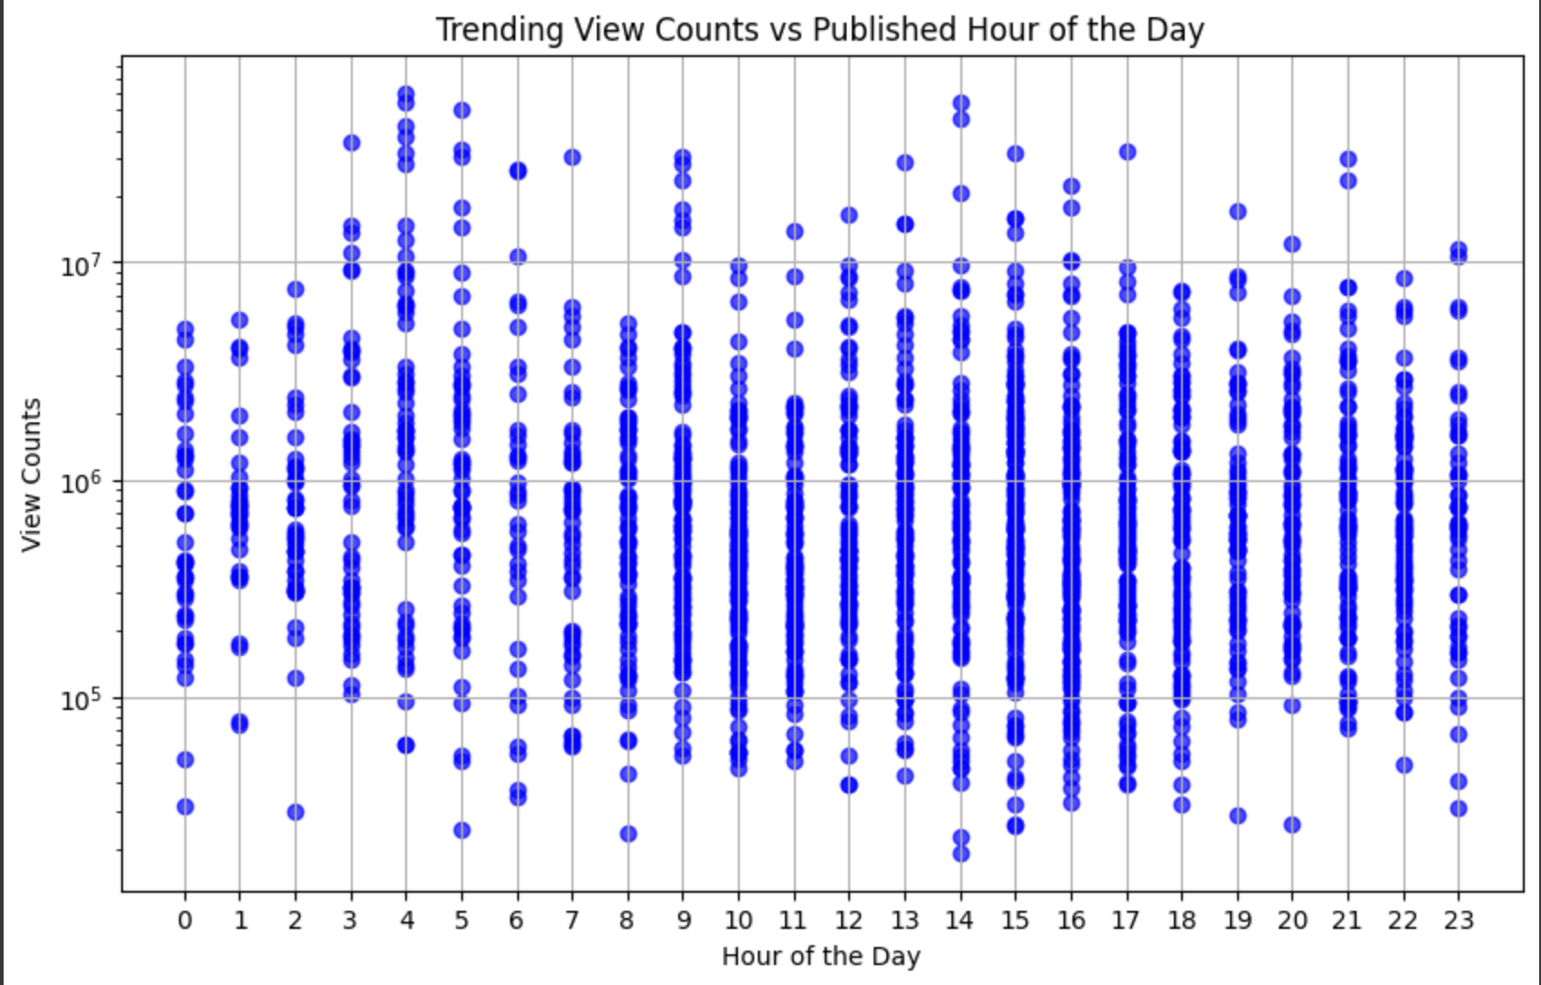
Data Visualization - Hour
Notes:
Then we looked at the differences in hours of publishing the video and days of the week that a video was published. Trending videos seem to be published at 2pm or early in the morning t on Thursday, friday, sunday or monday.
Non trending videos are published midday or early in the night on wednesdays or fridays.

Slide 16
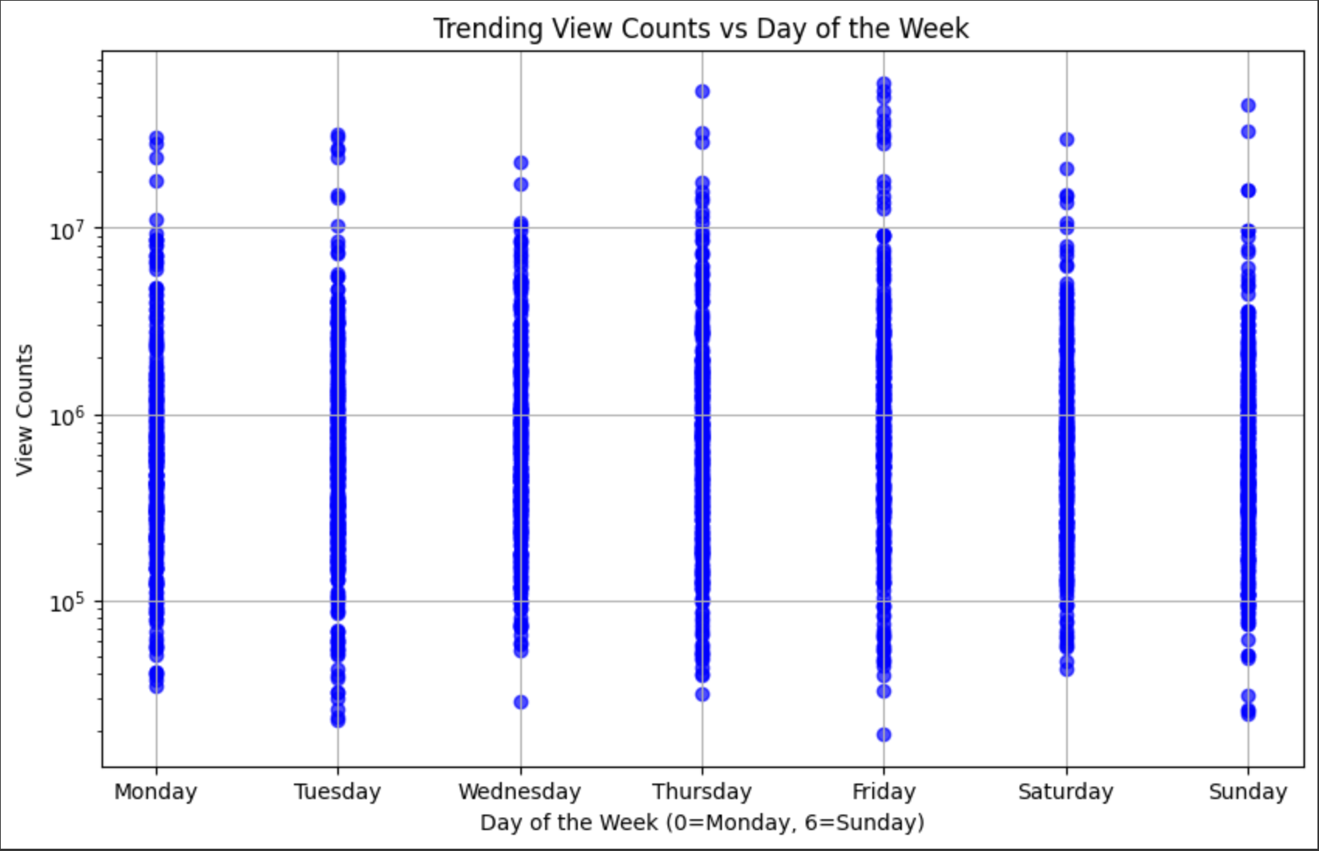
Data Visualization - Time and Day
Notes:
Then we looked at the differences in hours of publishing the video and days of the week that a video was published. Trending videos seem to be published at 4pm or late in the night on Thursday, friday, sun or monday.
Non trending videos are published midday or early in the night on wednesdays or fridays.
Post videos during thursday-sat or monday at 4pm or late night for max trending possibility.

Slide 17
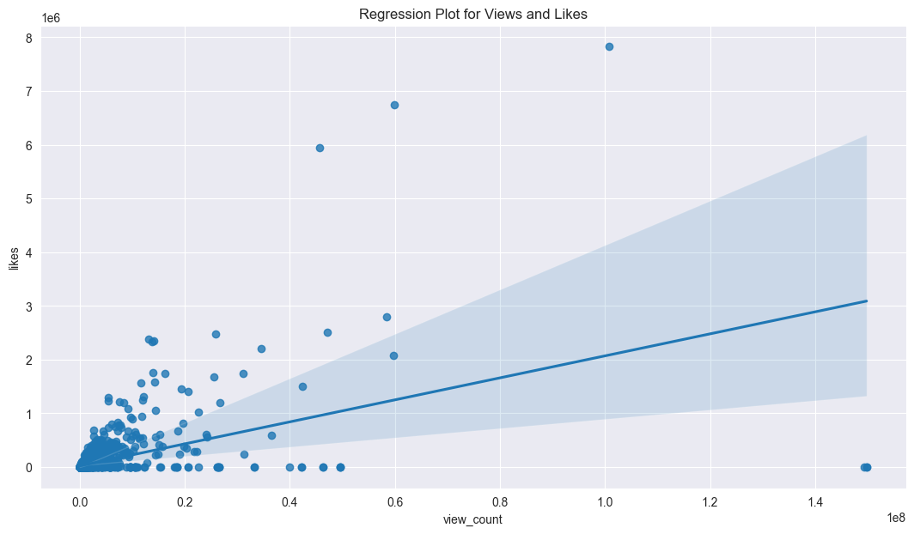
Data Visualization - Views and Likes
Notes:
Then we looked at the correlation between different columns . We created regression plots to see the correlations and there seems to be correlation between views likes dislikes and comment counts.

Slide 18
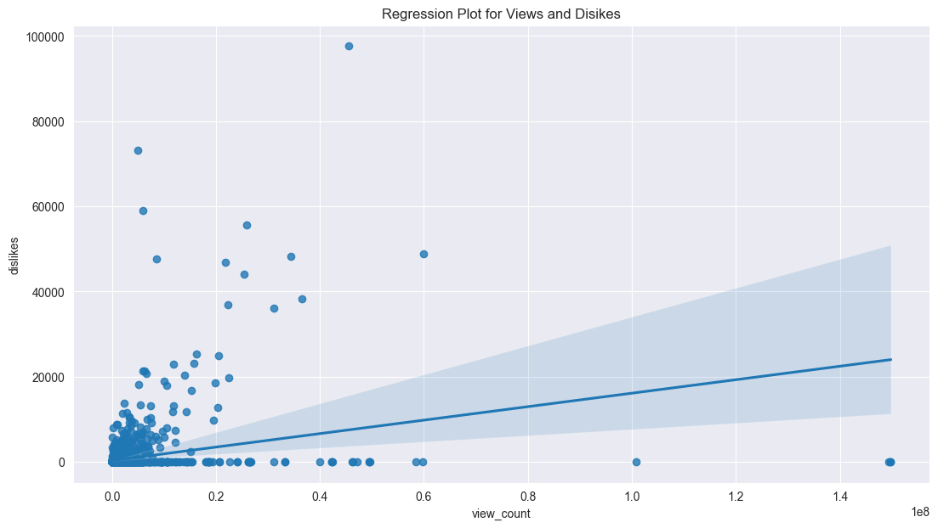
Data Visualization - Views and Dislikes
Notes:
Then we looked at the correlation between different columns . We created regression plots to see the correlations and there seems to be correlation between views likes dislikes and comment counts.

Slide 19
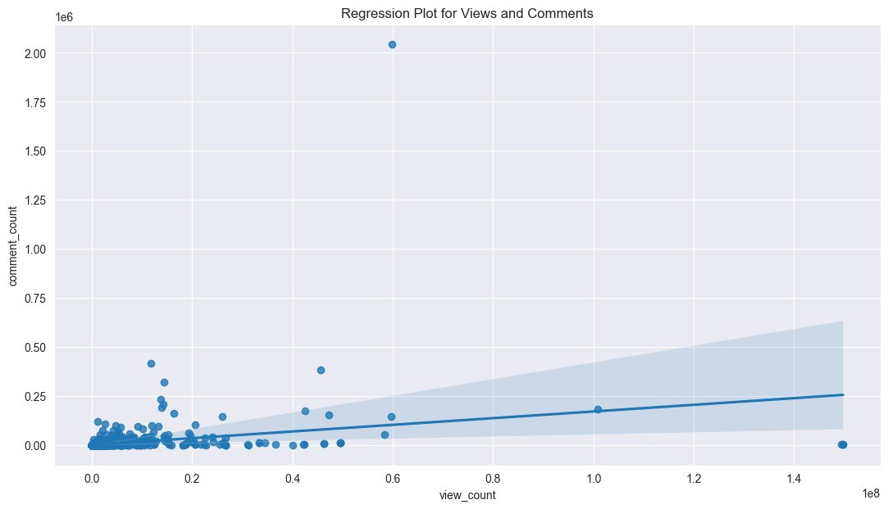
Data Visualization - Views and Comments
Notes:
Then we looked at the correlation between different columns . We created regression plots to see the correlations and there seems to be correlation between views likes dislikes and comment counts.

Slide 20
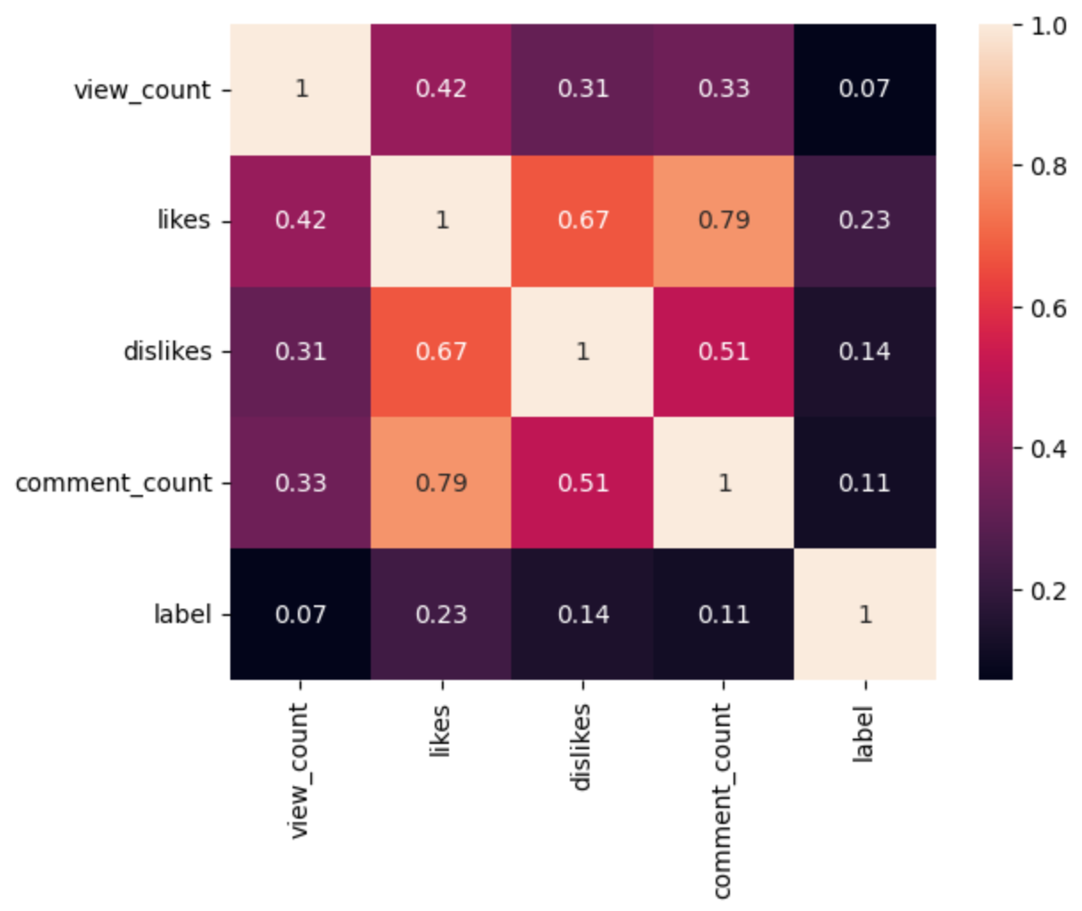
Data Visualization -
Notes:
here’s a heatmap that shows what we found. There is a high correlation between likes and trending label as expected. The least correlation is with the view counts surprisingly.

Slide 21
Classification
Notes:
Next we look at how to classify trending videos and non trending videos from the data. We picked two models to test. Logistic regression because it works well with small dataset. And also random forest as we wanted to avoid overfitting the data.

Slide 22
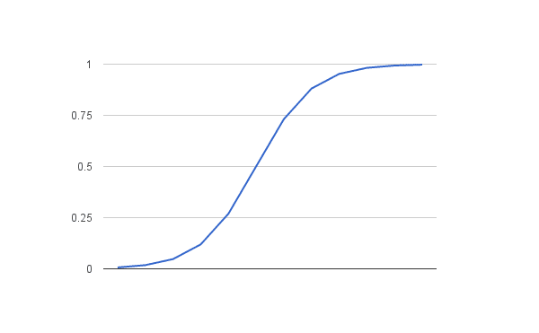
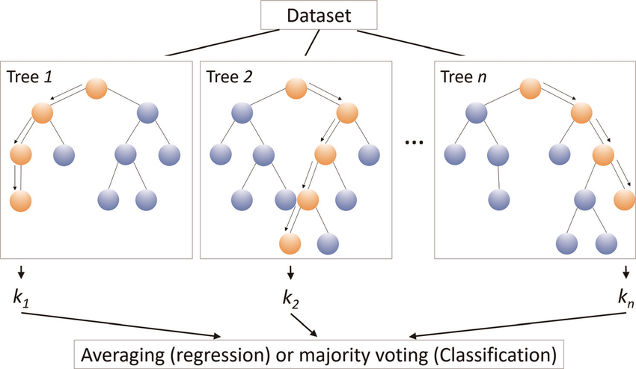
Models:
Model 1: Logistic regression
Model 2: Random forest
CEO
CFO
Sales Director
Berry Books
Vinny Viewer
Wendy Writer

Slide 23
Data Preprocessing
Step 1: Discretizing published date variable into a bin for year published
Step 2: Reconverting category id -> number
Step 3: Creating dummy variables
Step 4: Standardizing all numerical variables to be in the same scale
CEO
CFO
Sales Director
Wendy Writer
Notes:
Discretising published date variable into a bin for the year it was published
Reconverting category id into a number
Creating dummy variables for published date bins, hour of the day, day of the week and category id
Then we did logistic regression

Slide 24
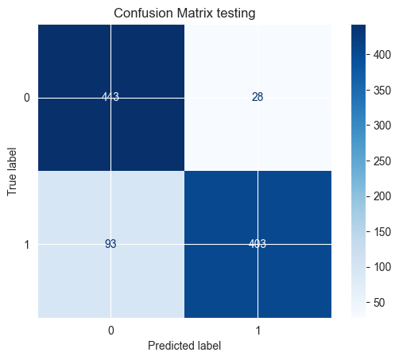
Logistic regression
Train score accuracy 0.8844
Test score accuracy 0.8748
Notes:
We found logistic regression giving us an accuracy of 87 percent. So this was good but we also wanted to test random forest.

Slide 25
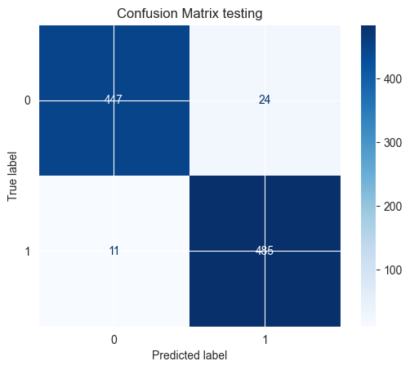
Random Forest
Train score 1.0
Test score 0.9838
Notes:
Random forest gave us It gave us accuracy of 99 percent with likes. But we felt that is a highly correlated variable and we should remove it from the mix. So finally since the random forest gives us more accuracy we decided that would be the best method for this classification.

Slide 26
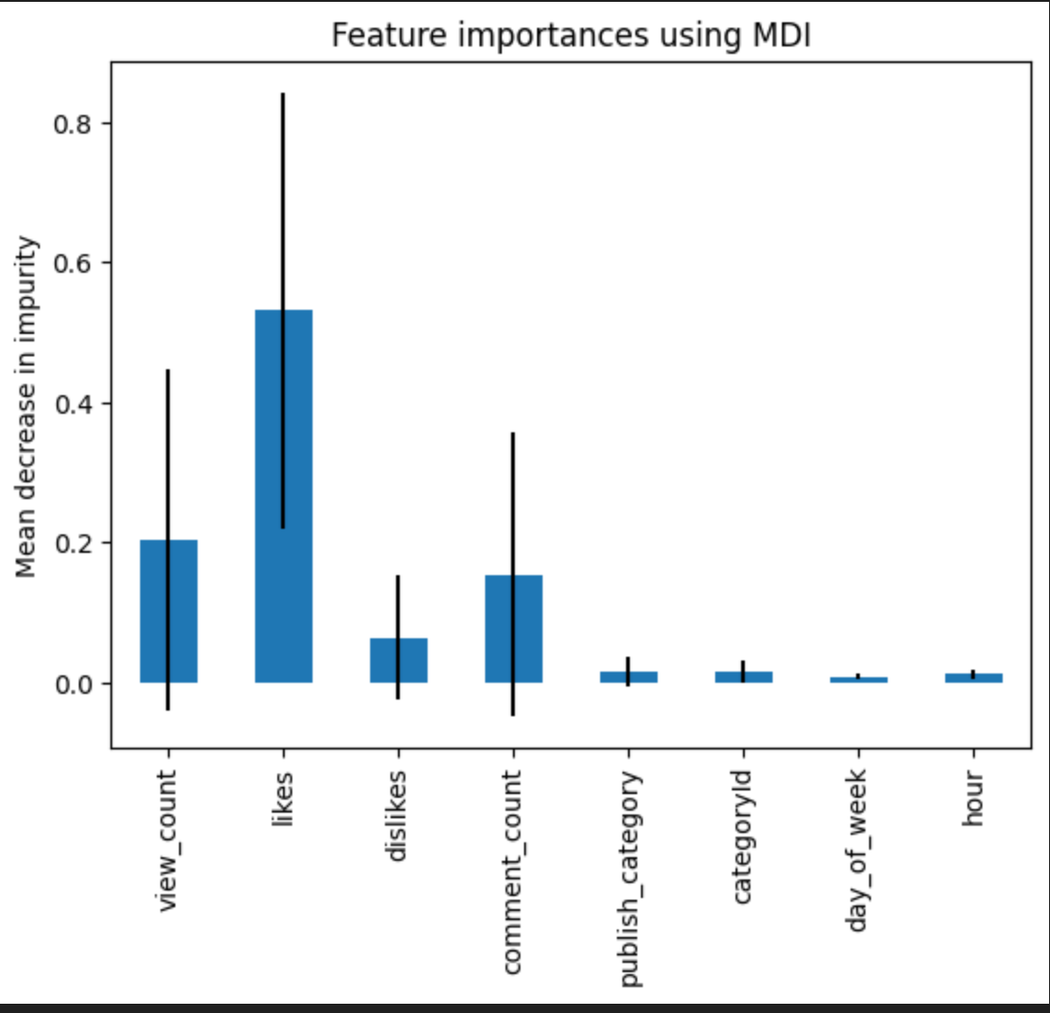
Notes:
So after eliminating the likes we see that viewcount and comment count are the next important features

Slide 27
Text Analysis
Notes:
Finally, let’s look into what keywords trending videos compose by building word clouds.

Slide 28
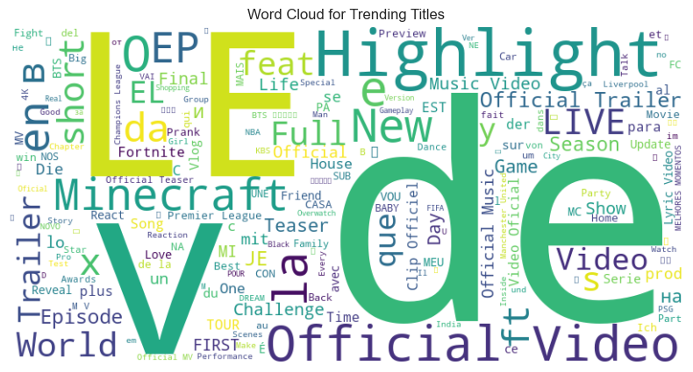
Notes:
-First, in video titles, Le, de, v, have the highest frequency as they are common words used in many languages.
-Following these are "official video" and “Highlight” which is intuitive
-also "Minecraft," because of its broad appeal, creative potential for creators, and strong community engagement.

Slide 29
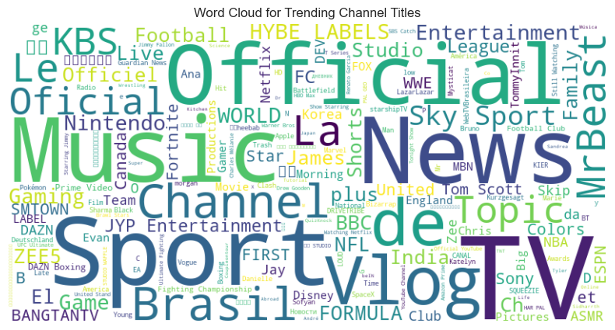
Notes:
-In channel titles, apart from "official", "Music" and "Vlog" are commonly featured. This observation aligns with the fact that videos in the music and travel/events categories tend to receive higher likes.
-“News” and “Sport” related channels are also very popular.
-Besides that, we can find MrBeast displayed at the right hand side, since he is the most-subscribed individual in the world.

Slide 30
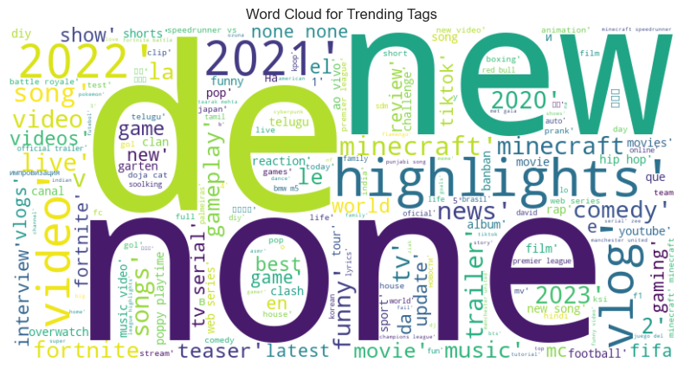
Notes:
-Similar to what has shown previously, in trending tags, the concept of “new” and “highlights” could grab viewers attention.
-You might wonder why there’s a big "none" here. Actually, it doesn’t represent a single tag but rather signifies that many videos have no hashtags.

Slide 31
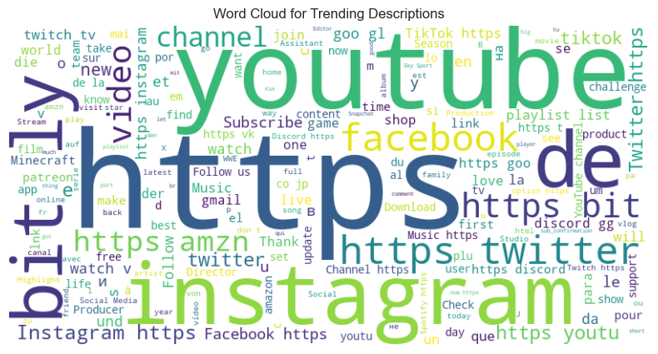
Notes:
-How about video descriptions? They commonly include relevant web links, and social media portals.
As this is often done to boost audience engagement, we can further infer that employing such methods could increase the likelihood of the video trending.

Slide 32
Questions for Exploration
What category do the trending videos on YouTube platform usually belong to?
What’s the best time in a day or week to upload videos?
1
3
2
What is the relationship between different metrics in a video, like views, likes, and comment counts?
4
Are there any key words or phrases that are common among popular videos?
Overall: What factors influence the popularity of a YouTube video?
Notes:
Going back to the questions we presented at the beginning…

Slide 33
Findings
“How to” & style, music, comedy, science and technology, news, and travel & events
Thurs, Fri, Sun, and Monday at 2pm or early in the morning
1
3
2
Likes are very important!
4
Look at the Word Cloud Above!
Overall: What factors influence the popularity of a YouTube video?
Notes:
Here’s a summary of our findings :
Most popular categories of videos are: How to and style, film and animation and music, entertainment, sports, comedy and travel and events.
Videos go trending within 2 days of being published.
Post videos between thurs,friday sunday or monday at 2pm or early morning for max possibility of going trending
Use the trending keywords in the title, channel title, tags and description of your video.
Likes are very important in order to gain the trending status as we observed with our classifiers and correlation matrix. Therefore, always motivate users to hit that like button.
These are all the useful insights we found from our analysis. We believe that using these would lead to success on youtube.
Thank you for your time. If you liked our presentation please hit that like button on peer reviews.

Slide 34
Findings
Popular Categories: How to & style,comedy, music,comedy, science and technology, news and travel & events
Trend timeline: 3 days of being published
Best time to post: Thurs,Fri,Sun and Monday at 2pm or early in the morning
Use trending keywords in title, channel title, tags & description
Likes are very important!
Notes:
Here’s a summary of our findings :
Most popular categories of videos are: How to and style, film and animation and music, entertainment, sports, comedy and travel and events.
Videos go trending within 3 days of being published.
Post videos between thurs,friday sunday or monday at 2pm or early morning for max possibility of going trending
Use the trending keywords in the title, channel title, tags and description of your video.
Likes are very important in order to gain the trending status as we observed with our classifiers and correlation matrix. Therefore, always motivate users to hit that like button.
These are all the useful insights we found from our analysis. We believe that using these would lead to success on youtube.
Thank you for your time. If you liked our presentation please hit that like button on peer reviews.

Slide 35

Thank you.

